Slide 1
Compiler Construction
Teacher : Zulfiqar Ali
Email: Zulfiqar.rafique@nu.edu.pk
Office: No.6,Basement -1 (CS Block 1)

Slide 2
Week 7:
Bottom-up Parsing
Reduction
Handle Pruning
Shift Reduce Parsing

Slide 3
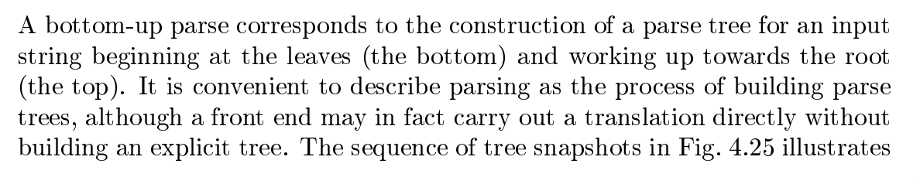
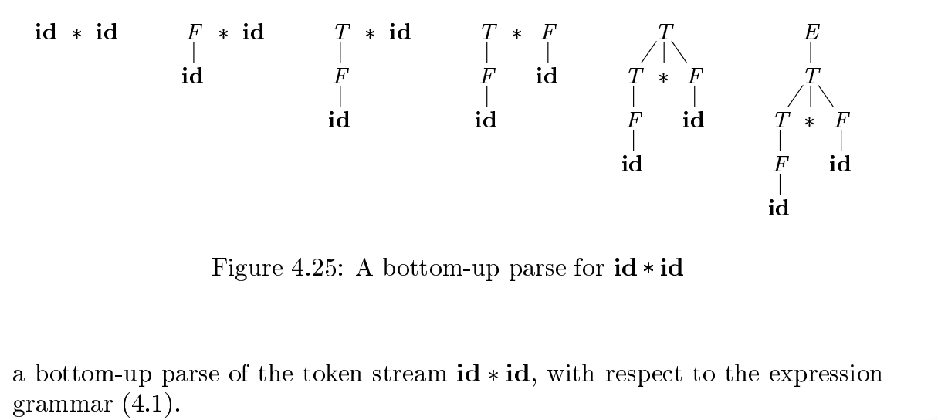
Bottom Up Parsing

Slide 4
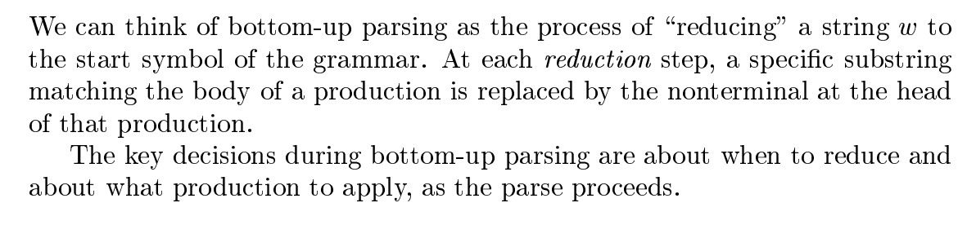
Reduction
d

Slide 5
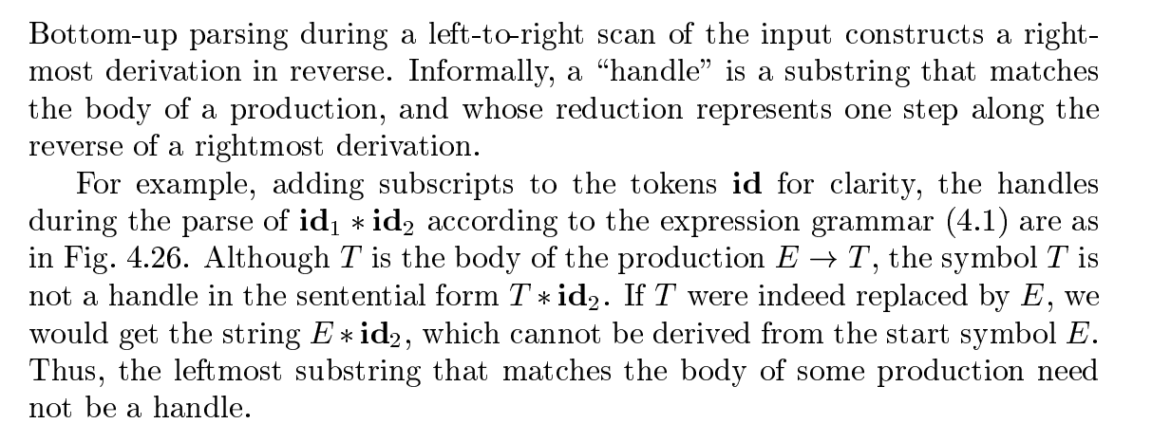
Handle Pruning

Slide 6
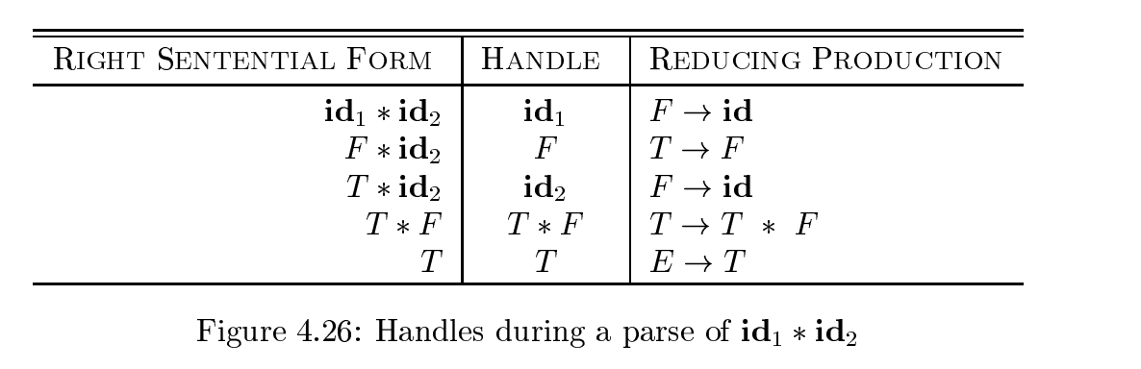
Handle Pruning

Slide 7
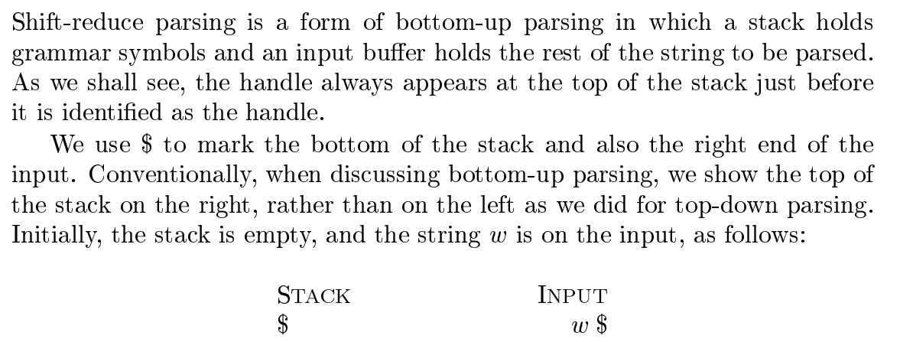
Shift Reducing Parsing

Slide 8
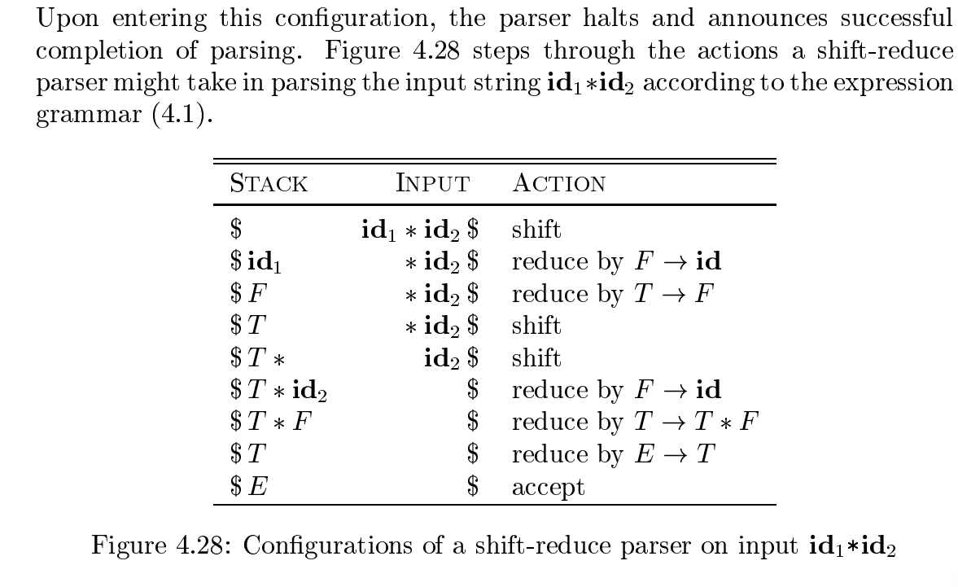
Grammar
E→E+T|T
T→T*F|F
F→ID

Slide 9
Examples
Consider the following grammar-
E → E – E E → E x E E → id
Parse the input string id – id x id using a shift-reduce parser.
Stack | Input Buffer | Parsing Action
$ | id – id x id $ | Shift id into stack
$id | - Id x id $ | Reduce E->Id
$E | - Id x id $ | Shift -
$E - | Id x id $ | Shift id into stack
$E- id | X id $ | Reduce E->id
$E- E | X id $ | Shift x into stack
$E-E x | Id $ | Shift id into stack
$E-E x id | $ | Reduce E->id
$E-Ex E | $ | Reduce ExE
$E-E | $ | Reduce E->E-E
$E | $

Slide 10
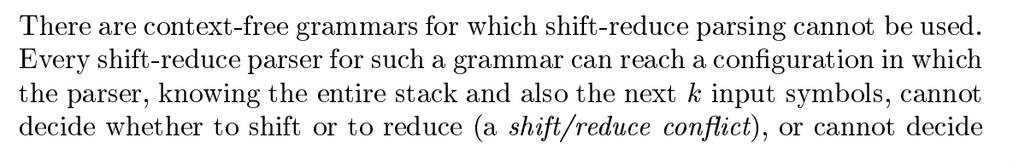
Conflicts in Shift Reduce Parsing
Types of Conflicts
Shift/Reduce conflicts
Reduce/Reduce Conflicts

Slide 11
Shift Reduce Conflicts
Grammar
S→aABe A→Abc|b B→d
Here we are not sure, whether shift or reduce will lead to parse successful
Stact | Input String | Actoin | Issue/Conflix
$ | abbcde$ | Shift
$a | bbcde$ | Shift b
$ab | bcde$ | Reduce b→A | Here there is a conflict, whether we do shift next string or reduce b→A
$aA | bcde$ | Shift b
$aAb | cde$ |  | Again we have shift/reduce conflict

Slide 12
Reduce/Reduce Conflicts
Grammar
S→aABe|b A→Abc|b B→d
Here we are not sure, whether shift will be successful parsing
Stack | Input String | Action | Issue/Conflict
$ | abbcde$ | Shift
$a | bbcde$ | Shift b
$ab | bbcde$ | Reduce b→B | Here there is a conflict, we have 2 reduce options, we can reduce b→S also can b→A

Slide 13
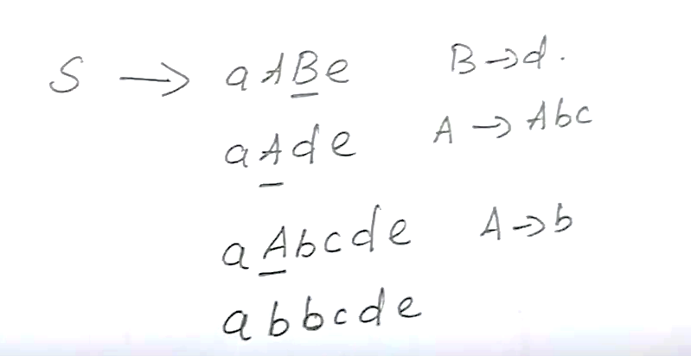
Solution for Conflicts
To avoid the conflicts do Right Most Derivation RMD first, for the given input string, as per grammar.

Slide 14
Shift Reduce Conflicts (solved
Grammar
S→aABe A→Abc|b B→d
Stact | Input String | Actoin
$ | abbcde$ | Shift
$a | bbcde$ | Shift b
$ab | bcde$ | Reduce b→A
$aA | bcde$ | Shift b
$aAb | cde$ | Shift c
$aAbc | de$ | Reduce A→Abc
$aA | de$ | Shift d
$aAd | e$ | Reduce d
$aAB | e$ | Shift e
$aABe | $ | Reduce S→aABe
$S | $ | Accept

Slide 15
LR(0) Introduction to LR Parsing: Simple LR
The most prevalent type of bottom-up parser today is based on a concept called LR(k) parsing;
The LR parser is an efficient bottom-up syntax analysis technique that can be used for a large class of context-free grammar.
L stands for the left to right scanning
R stands for rightmost derivation in reverse
k stands for no. of input symbols of lookahead.
The cases k = 0 or k = 1 are of practical interest, and we shall only consider LR parsers with k <= 1 here. When (k) is omitted, k is assumed to be 1

Slide 16
LR Parsers
LR parsers are table-driven, much like the non-recursive LL parsers.
A grammar for which we can construct a parsing table using one of the methods in this section and the next is said to be an LR grammar.
Intuitively, for a grammar to be LR it is sufficient that a left-to-right shift-reduce parser be able to recognize handles of right-sentential forms when they appear on top of the stack.

Slide 17
Why LR Parser
LR parsers can be constructed to recognize virtually all programming language constructs for which context-free grammars can be written.
Non LR context-free grammars exist, but these can generally be avoided for typical programming-language constructs.
The LR-parsing method is the most general non-backtracking shift-reduce parsing method known, yet it can be implemented as efficiently.
An LR parser can detect a syntactic error as soon as it is possible to do so on a left-to-right scan of the input.

Slide 18
Why LR Parser
Most powerful deterministic context-free grammar parser practical for implementation.
Can handle a wider class of grammars than LL parsers (e.g., left-recursion).
Grammar writing is easier and more natural due to less restrictions.
Better error detection as parsing is deferred until a reduction happens.
Well-suited for automatic parser generation from grammar specifications.
High parsing efficiency with O(n) time complexity for most inputs.
Left-to-right scanning with Rightmost derivation provides optimal lookahead.
Excellent for programming languages where grammar complexity is high.

Slide 19
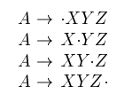
Items and LR(0) Automation
How does a shift-reduce parser know when to shift and when to reduce?
An LR parser makes shift-reduce decisions by maintaining states to keep track of where we are in a parse.
States represent sets of items." An LR(0) item (item for short) of a grammar G is a production of G with a dot at some position of the body. Thus, production A → XYZ yields the four items.
The production A → Epsilon generates only one item, A→.

Slide 20
Items and LR(0) Automation
Intuitively, an item indicates how much of a production we have seen at a given point in the parsing process. For example, the item A ->.X Y Z indicates that we hope to see a string derivable from X Y Z next on the input.
A -> X.Y Z indicates that we have just seen on the input a string derivable from X and that we hope next to see a string derivable from Y Z.
Item A → XYZ indicates that we have seen the body XY Z and that it may be time to reduce XY Z to A.

Slide 21
One collection of sets of LR(0) items, called the canonical LR(0) collection, provides the basis for constructing a deterministic finite automaton that is used to make parsing decisions.
Such an automaton is called an LR(0) automaton.
In particular, each state of the LR(0) automaton represents a set of items in the canonical LR(0) collection..

Slide 22
Augmented Grammar
To construct the canonical LR(0) collection for a grammar, we define an augmented grammar and two functions, CLOSURE and GOTO.
If G is a grammar with start symbol S, then G’, the augmented grammar for G, is G’ with a new start symbol S’ and production S’-> S.
The purpose of this new starting production is to indicate to the parser when it should stop parsing and announce acceptance of the input.
That is, acceptance occurs when and only when the parser is about to reduce by S’→ S.

Slide 23
Closure()
The CLOSURE() operation takes a set of LR(0) items as input and expands it by adding all possible items implied by the current set. An LR(0) item is a production rule with a dot • indicating the parsing progress, such as A → α•Xβ.
Rule: If an item A → α•Bβ is in the set, and B is a non-terminal, then for every production B → γ in the grammar, the item B → •γ must be added to the set. This process is repeated until no new items can be added.
Example: If I contains E → •T and T → id is a production, then CLOSURE(I) would also include T → •id.

Slide 24
GOTO()
The GOTO() operation determines the next state the LR parser will transition to after recognizing a specific grammar symbol (terminal or non-terminal).
Rule: GOTO(I, X) takes a set of items I (a state) and a grammar symbol X. It identifies all items in I where the dot • is immediately followed by X (e.g., A → α•Xβ). For each such item, it moves the dot past X (e.g., A → αX•β), collects these new items into a set, and then computes the CLOSURE() of this new set. The resulting set is the target state.
Example: If I contains E → •T and T is a non-terminal, then GOTO(I, T) would result in a new state containing E → T• and its closure.

Slide 25
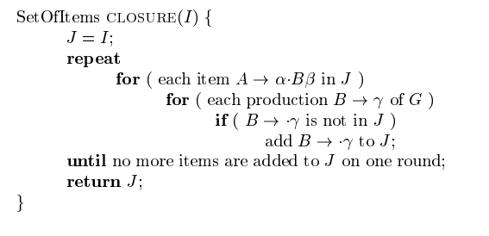

Slide 26
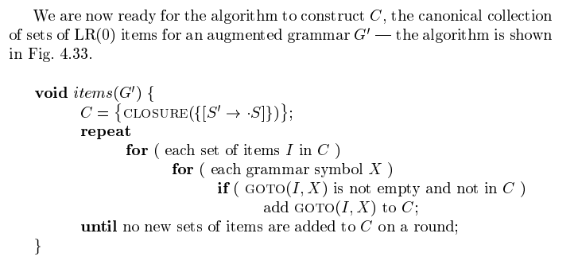
Constructing Canonical Items

Slide 27
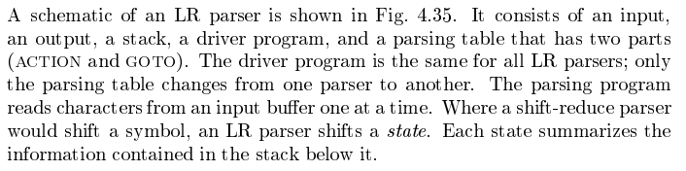
LR Parsing Algorithm

Slide 28
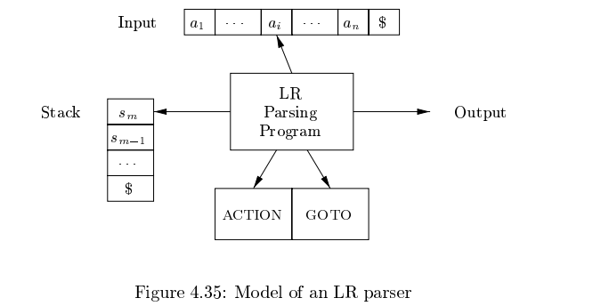

Slide 29
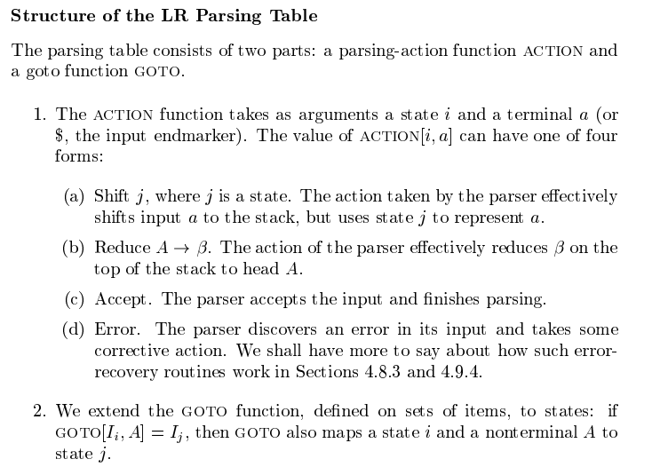

Slide 30
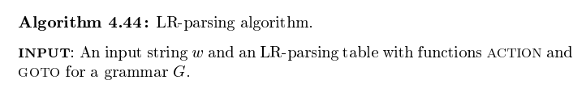
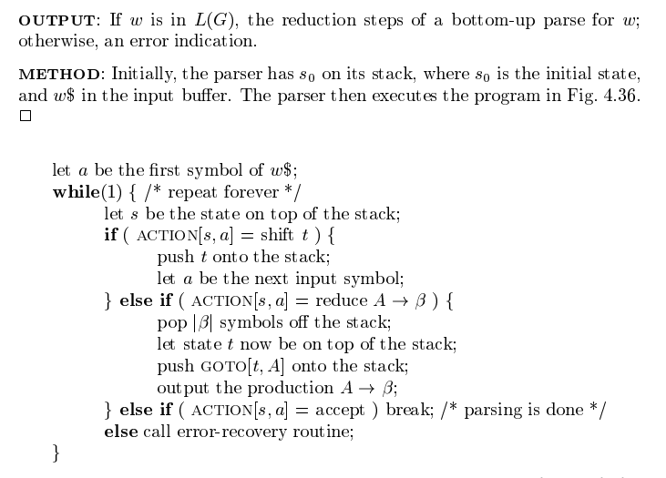

Slide 32
Example of LR(0) Parser
Consider a Grammar.
S–>AA A–>aA|b
STEP 1- Find augmented grammar –
The augmented grammar of the given grammar is:-
S’–>.S [0th production]
S–>.AA [1st production]
A–>.aA [2nd production]
A–>.b [3rd production]

Slide 33
Explanation of Graph (Data Flow Graph)
In the figure, I0 consists of augmented grammar.
Io goes to I1 when ‘ . ‘ of 0th production is shifted towards the right of S(S’->S.). This state is the accepted state.
S is seen by the compiler
Io goes to I2 when ‘ . ‘ of 1st production is shifted towards the right (S->A.A) . A is seen by the compiler
I0 goes to I3 when ‘ . ‘ of the 2nd production is shifted towards the right (A->a.A) . a is seen by the compiler.
I0 goes to I4 when ‘ . ‘ of the 3rd production is shifted towards the right (A->b.) . b is seen by the compiler.
I2 goes to I5 when ‘ . ‘ of 1st production is shifted towards the right (S->AA.) . A is seen by the compiler

Slide 34
Explanation of Graph (Data Flow Graph)
I2 goes to I4 when ‘ . ‘ of 3rd production is shifted towards the right (A->b.) . b is seen by the compiler.
I2 goes to I3 when ‘ . ‘ of the 2nd production is shifted towards the right (A->a.A) . a is seen by the compiler.
I3 goes to I4 when ‘ . ‘ of the 3rd production is shifted towards the right (A->b.) . b is seen by the compiler.
I3 goes to I6 when ‘ . ‘ of 2nd production is shifted towards the right (A->aA.) . A is seen by the compiler
I3 goes to I3 when ‘ . ‘ of the 2nd production is shifted towards the right (A->a.A) . a is seen by the compiler.

Slide 35
STEP3 – defining 2 functions: goto[list of non-terminals] and action[list of terminals] in the parsing table

Slide 36
Explanation of creating table
$ is by default a nonterminal that takes the accepting state.
0,1,2,3,4,5,6 denotes I0,I1,I2,I3,I4,I5,I6
I0 gives A in I2, so 2 is added to the A column and 0 rows.
I0 gives S in I1, so 1 is added to the S column and 1 row.
similarly, 5 is written in A column and 2nd row, 6 is written in A column and 3 rows.

Slide 37
Explanation of creating table
I0 gives an in I3 to .so S3(shift 3) is added to a column and 0 rows.
I0 gives b in I4, so S4(shift 4) is added to the b column and 0 rows.
Similarly, S3(shift 3) is added on a column and 2,3 rows, S4(shift 4) is added on b column and 2,3 rows.
I4 is reduced state as ‘ . ‘ is at the end. I4 is the 3rd production of grammar. So write r3(reduce 3) in terminals.
I5 is reduced state as ‘ . ‘ is at the end. I5 is the 1st production of grammar. So write r1(reduce 1) in terminals.
I6 is reduced state as ‘ . ‘ is at the end. I6 is the 2nd production of grammar. So write r2(reduce 2) in terminals.

Slide 38
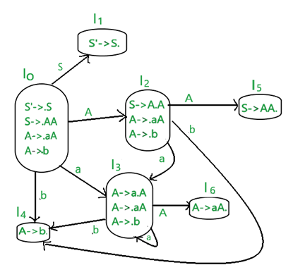
STEP 2 – Find LR(0) collection of items
Below is the figure showing the LR(0) collection of items. We will understand everything one by one.
The terminals of this grammar are {a,b}
The non-terminals of this grammar are {S,A}
RULE – if any nonterminal has ‘ . ‘ preceding it, we have to write all its production and add ‘ . ‘ preceding each of its-production.
RULE – from each state to the next state, the ‘ . ‘ shifts to one place to the right.

Slide 39
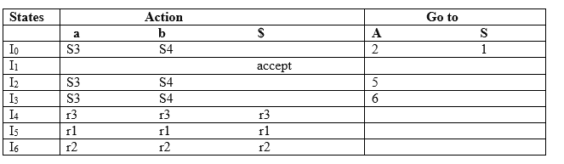

Slide 40
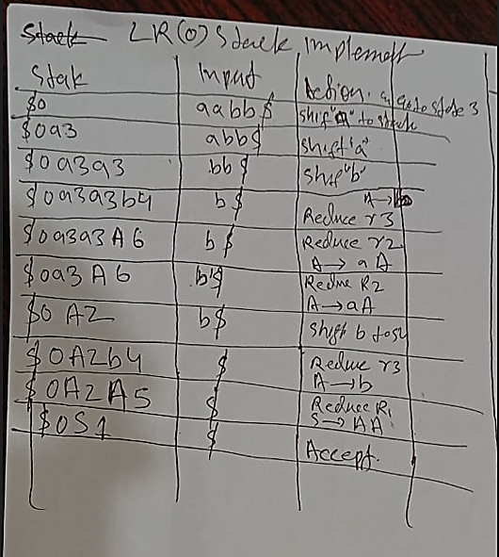
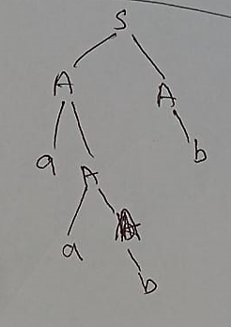

Slide 41
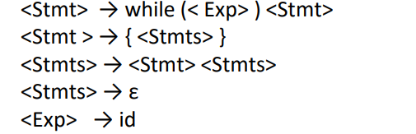
Try This Example

Slide 42
SLR(1) Parser
SLR (1) refers to simple LR Parsing. It is same as LR(0) parsing.
The only difference is in the parsing table.
To construct SLR (1) parsing table, we use canonical collection of LR (0) item.
In the SLR (1) parsing, we place the reduce move only in the follow of left hand side.

Slide 43
Various steps involved in the SLR (1) Parsing:
For the given input string write a context free grammar
Check the ambiguity of the grammar
Add Augment production in the given grammar
Create Canonical collection of LR (0) items
Draw a data flow diagram (DFA)
Construct a SLR (1) parsing table

Slide 44
SLR (1) Table Construction

Slide 45
The steps which use to construct SLR (1) Table is given below:
If a state (Ii) is going to some other state (Ij) on a terminal then it corresponds to a shift move in the action part.
If a state (I_{i}) is going to some other state (I_{j}) on a variable then it correspond to go to move in the Go to part.
If a state (I_{i}) contains the final item like A → ab• which has no transitions to the next state then the production is known as reduce production. For all terminals X in FOLLOW (A), write the reduce entry along with their production numbers.

Slide 46
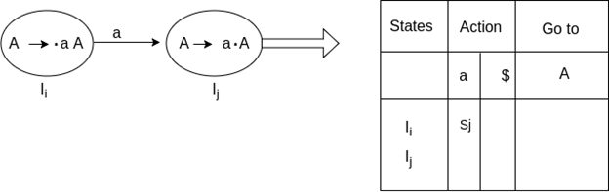
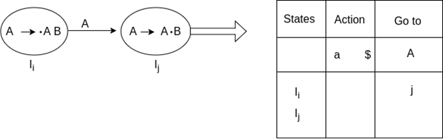
Steps Diagrams

Slide 47
Example of SLR(1)
SLR ( 1 ) Grammar
S → E E → E + T | T T → T * F | F F → id
Add Augment Production and insert '•' symbol at the first position for every production in G
S` → •E E → •E + T E → •T T → •T * F T → •F F → •id

Slide 48
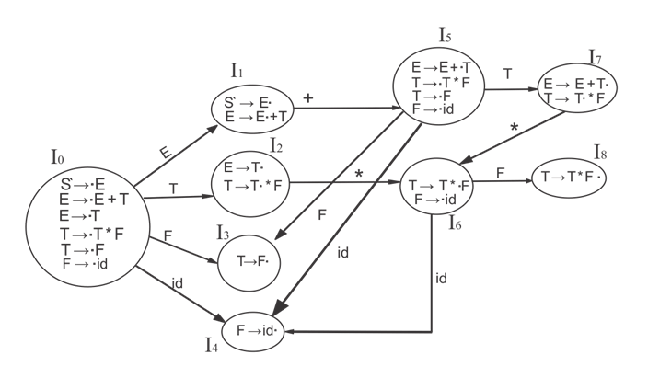

Slide 49
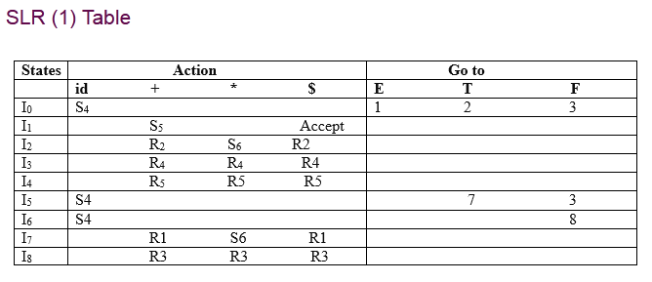

Slide 50
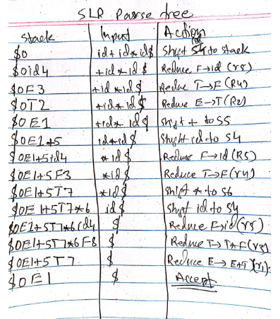
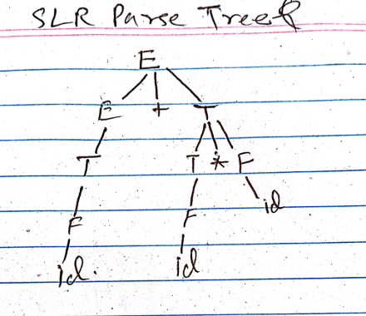

Slide 51
Explanation of Table Creation
First (E) = First (E + T) ∪ First (T)
First (T) = First (T * F) ∪ First (F)
First (F) = {id}
First (T) = {id}
First (E) = {id}
Follow (E) = First (+T) ∪ {$} = {+, $}
Follow (T) = First (*F) ∪ First (F)
= {*, +, $}
Follow (F) = {*, +, $}

Slide 52
I1 contains the final item which drives S → E• and follow (S) = {$}, so action {I1, $} = Accept
I2 contains the final item which drives E → T• and follow (E) = {+, $}, so action {I2, +} = R2, action {I2, $} = R2
I3 contains the final item which drives T → F• and follow (T) = {+, *, $}, so action {I3, +} = R4, action {I3, *} = R4, action {I3, $} = R4

Slide 53
I4 contains the final item which drives F → id• and follow (F) = {+, *, $}, so action {I4, +} = R5, action {I4, *} = R5, action {I4, $} = R5
I7 contains the final item which drives E → E + T• and follow (E) = {+, $}, so action {I7, +} = R1, action {I7, $} = R1
I8 contains the final item which drives T → T * F• and follow (T) = {+, *, $}, so action {I8, +} = R3, action {I8, *} = R3, action {I8, $} = R3

Slide 54
Conflicts
RR- Reduce Reduce Conflicts
A grammar
A->a B->b C->aB
Augmented Grammar
S->.A A->.a B->.b C->.aB

Slide 55
Try this examples
S→E
E→if E then E
E→if E then E else E
E→id

Slide 56
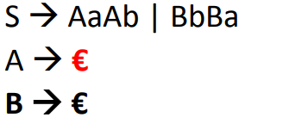
Try This Example on LR Parser

Slide 57
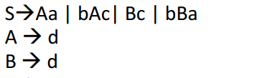
Another Example

Slide 58

Another Example
Ff

Slide 59
Reference:
Compilers: Principles, Techniques, and Tools 2nd Edition by Alfred Aho , Jeffrey Ullman, Ravi Sethi, Monica Lam
Introduction to Compilers and Language Design | Second Edition | Prof. Douglas Thain - University of Notre Dame

